Slide 1
CIS041-3 Advanced Information Technology
Web Information Retrieval 1 -
Web search and PageRank
Gangmin Li
(Office hours: 13:00-17:00 every Friday)

Slide 2
What we have learnt
Information seeking and Information Retrieval
Document representation and indexing
Boolean retrieval model
Tf-idf for ranking
Vector space retrieval model

Slide 3
Outline
Web information Retrieval (specific features)
How to find important page?
Web as a directed graph
Why links alone is not a good idea
Random walk (overcome link number’s problem)
PageRank (google algorithm)

Slide 4
Web Information Retrieval
Web search

Slide 5
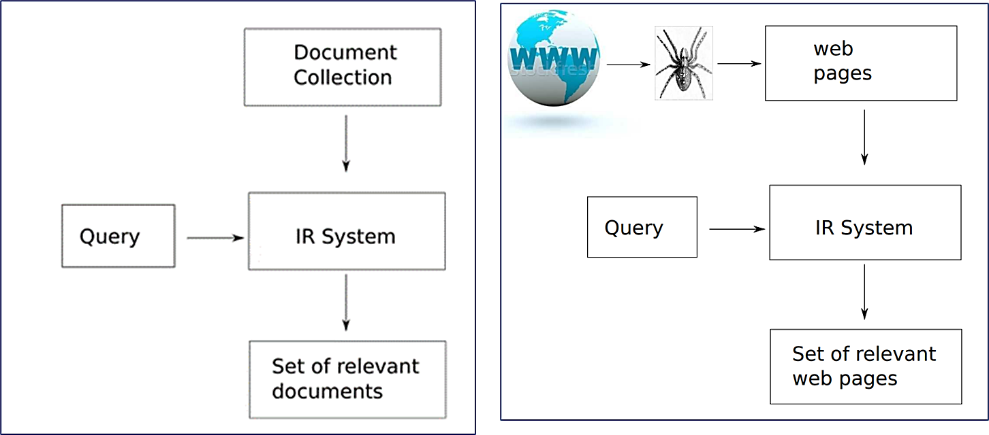
Two ways of IR (lecture2)
General IS
Web-based IS

Slide 6
What is Web?
Web is the common name for the World Wide Web.
A subset of the Internet consisting of the web pages that can be accessed by a Web browser.
Web pages are formatted in a language called Hypertext Markup Language (HTML).
Browser is the interpreter of HTML, makes it visitable to human.
User click through pages on the Web via links
All Internet resources and users using the Hypertext Transfer Protocol (HTTP)

Slide 7
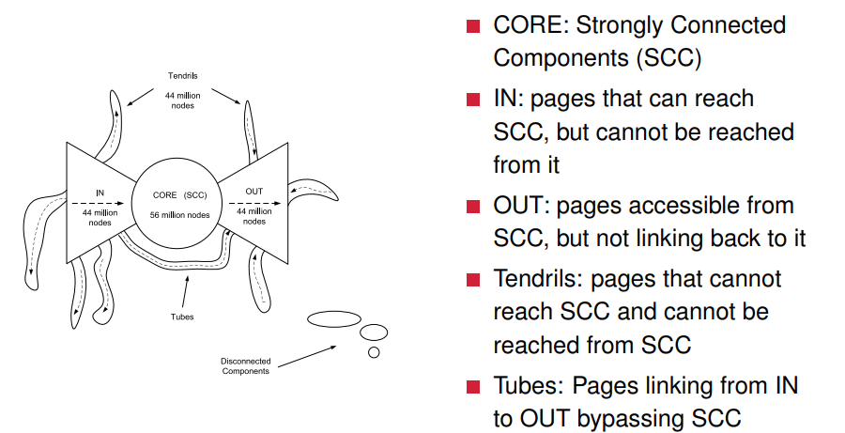
Web as a Bowtie Structure

Slide 8
Taxonomy of web search
The "need behind the query" is often not informational ONLY in nature.
Navigational: Aim is to reach a particular site
Informational: Acquire some information present on a web site
Transactional: Find web pages where some further interaction will happen (e.g., shopping)
Resource: To get access to some online resource

Slide 9
The Search Behaviours
Surfing: Following links in a rather unsystematic way ("leisure surfing")
Browsing: Following links systematically
Searching: Query-based document access

Slide 10
Browsing
Document search is done by navigating to interesting relevant categories
Catalogues (like Yahoo! and DMOZ and many others) are often a hierarchical category scheme (next slide)
Each Web document in this catalogue is assigned to one or more categories, which gives useful hints about the document topic
Topic gets more specific the deeper we get

Slide 11
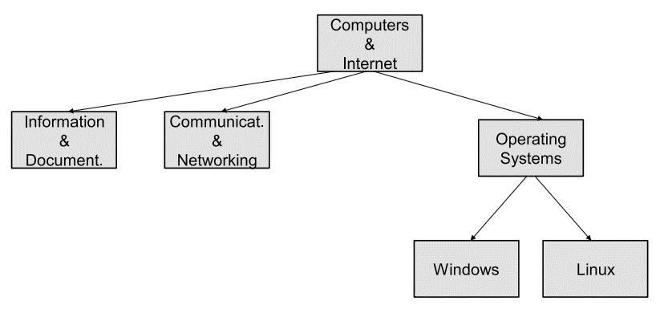
Hierarchical Category Scheme Example Yahoo! Computers & Internet

Slide 12
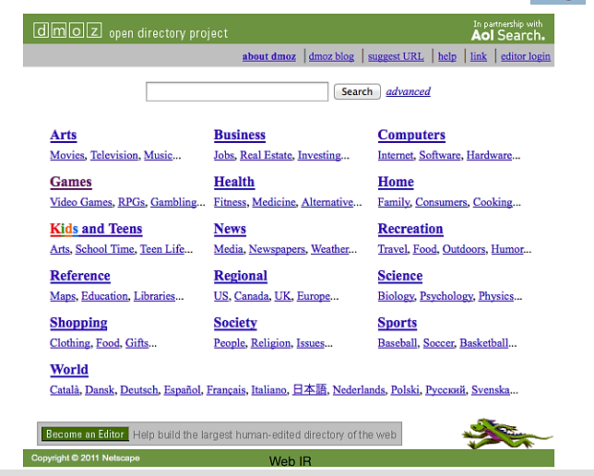
Hierarchical Category Scheme Example DMOZ

Slide 13
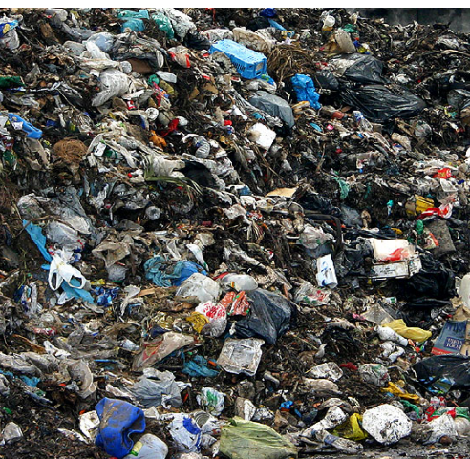
The problem
Exponential information growth
Vanishing documents (404)
Heterogeneous document types
Document quality
Multilinguality

Slide 14
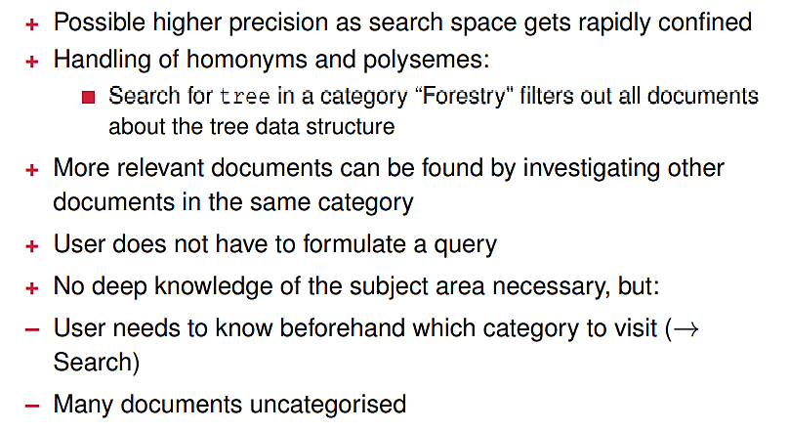
Browsing Advantages and Disadvantages

Slide 15
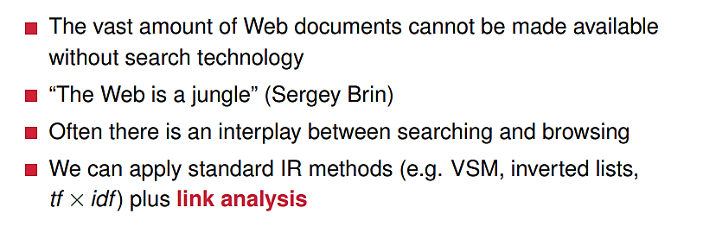
Searching

Slide 16
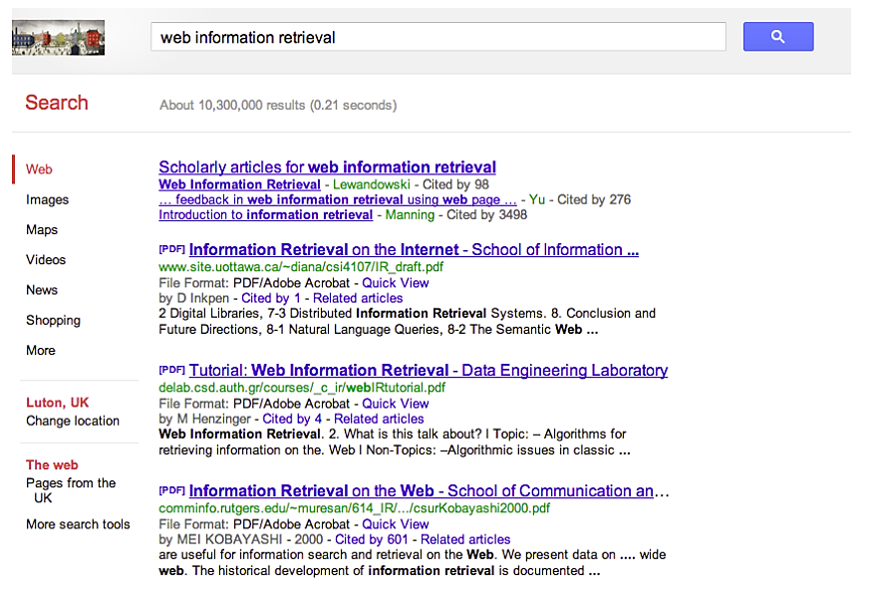
Anatomy of a Web search Engine
The earlier Google

Slide 17
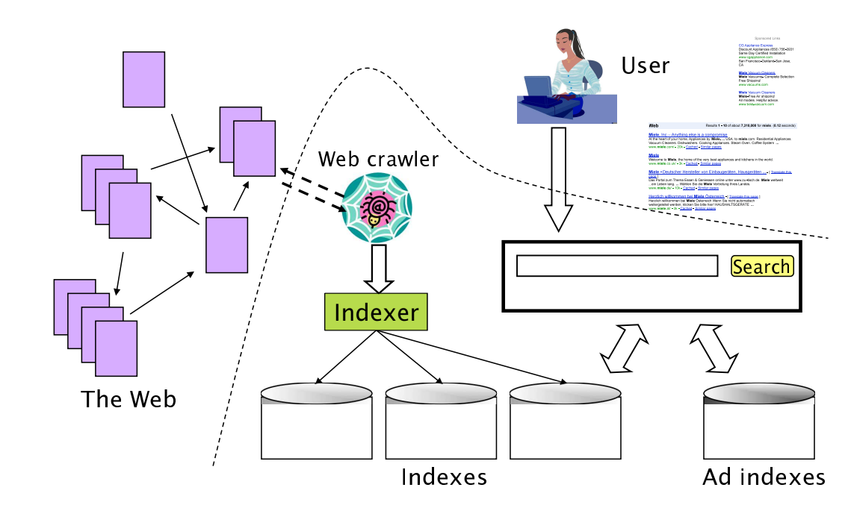




A web search engine

Slide 18
Web Search Engine Components
Webcrawler/Spider Collects Web sites, interacts with Web servers, follows links to new Web pages
Parser/Indexer Extracts keywords from full texts, indexes the documents
Storage System Efficient storage of the extracted and processed information (e.g. in a database with inverted lists)
User Interface Query input, interacts with the storage system
Rather simple components
Has to cope with huge amounts of data and very high access rates

Slide 19
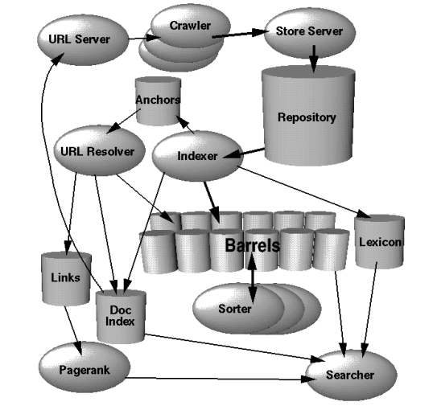
Google High Level Architecture [Brin and Page, 1998]

Slide 20

Google Architecture: Components
URL Server Collects lists of URLs to visit from the document index, sends them to the crawler
Crawler Collects and accesses Web sites
Store Server Compresses Web sites, stores them in a repository, assigns document IDs

Slide 21
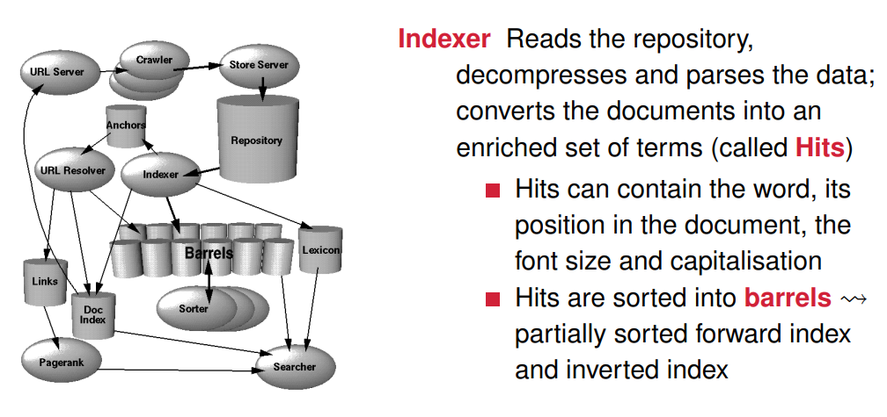
Google Architecture: Components

Slide 22
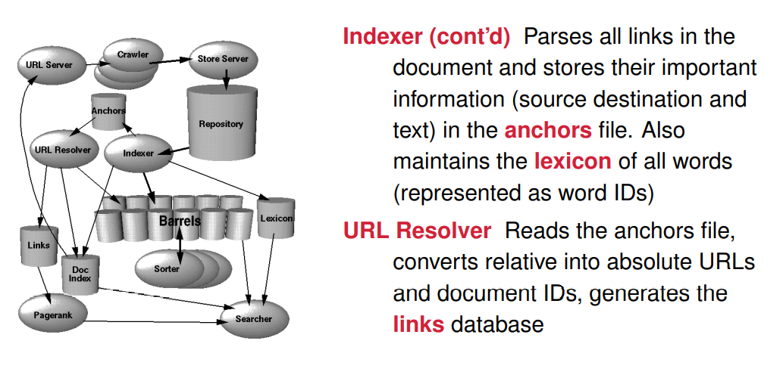
Google Architecture: Components

Slide 23
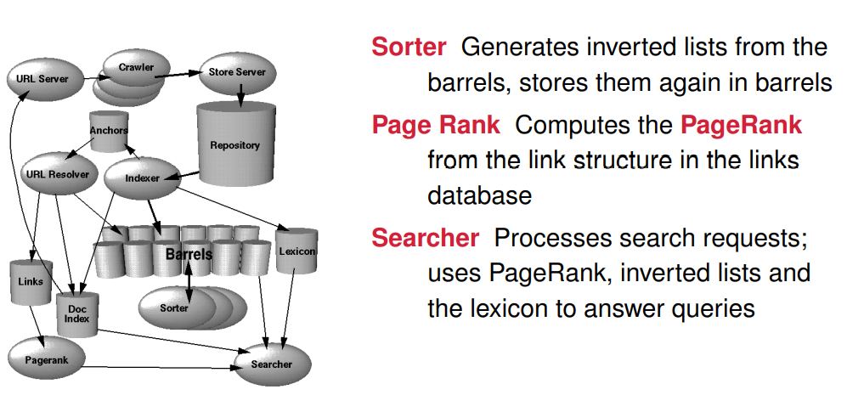
Google Architecture: Components

Slide 24
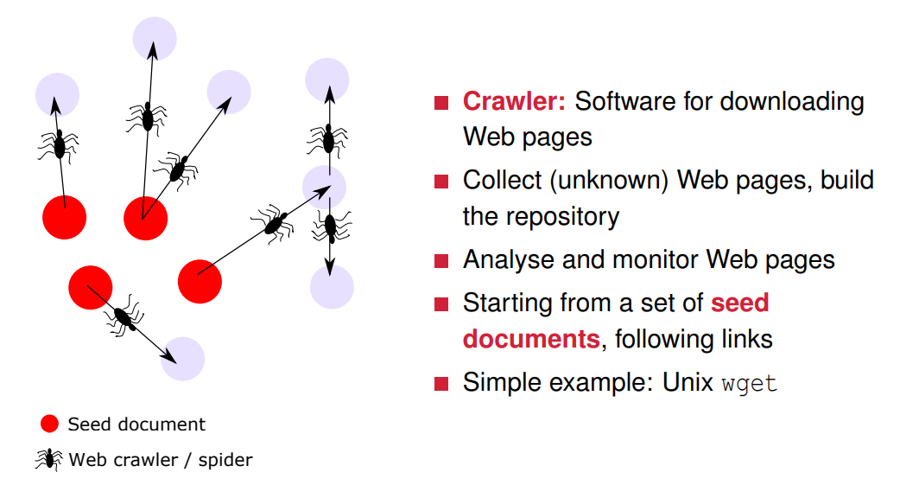
Web Crawler
The wget command in Linux is a command used to download files from the web.

Slide 25
Google Hit Types
Google NOT ONLY looks for the occurrence of a term (or word, as general IR methods do), but also separates between 3 different types of occurrences (called Hits):
(Hits in google can have many meanings such as visit and file being downloaded, triggers of recording. Here HITs simply mean terms appeared in different places)
Fancy Hit Includes hits occurring in a URL, title, or meta tag
Anchor Hit Special kind of fancy hit, occurrence in an anchor text linking to the page (anchor propagation)
Plain Hit All the rest

Slide 26
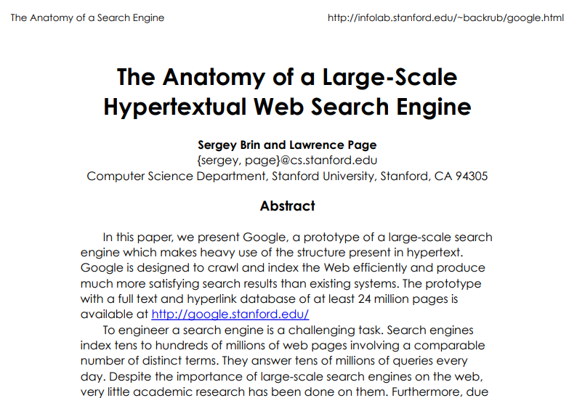
Examples of Google Hits
… Architecture of Search Engine
provided by Google
Anchor Hit
Fancy Hit
Google ?
Plain Hit

Slide 27
The Purposes of the Hits
Doing more than traditional IR (ONLY looking items in the document).
More information source (item appeared in different places – Hits). Normal IR methods can be adopted for terms appeared in those places. Such as
Using the inverted index, to retrieve all hits of a query term in a document (full text, fancy and anchor)
Using tf ×idf on Hits, by compute the dot product between a type-weight vector (full text, anchor, fancy) and a count–weight vector (counting number of full text, anchor and fancy hits) to create the document score. (NOT on full documents)
More methods can be used to define relevancy of the return (page) to user query term (assign different weight to different types of Hits.

Slide 28
Google Secret
Google claimed use Hits types to calculation of importance of figures/signals/pages and to rank documents returned w.r.t. the query
Precise ranking function kept secret
Ranking function (based on the importance calculation) considers the position of terms in the document, their font size, capitalisation information, Links with others (Linked by important document or pages), …

Slide 29
Google’s Success
Google search engine appears performing better than many other search engines and stands out among the competition.
Their success done to the techniques of finding related web pages w.r.o user’s search term.
Google make use of LINKs and Anchor text for their search engine.
These techniques published are:
PageRank (Determining importance of pages )
HITS (Determining hubs and authorities of a certain topic)

Slide 30
PageRank
Find importance of a page on the Web
How Google's PageRank Algorithm Works

Slide 31
Web page is different to document
We have established:
Web information retrieval is NOT only find information contained in the web pages. But all information retrieval techniques can be used to determine the return for a query. (like inverted lists, tf ×idf)
Actual search engine does (2 steps process):
Computing the retrieval status value (RSV) w.r.t. a query,
Rank documents with a decreasing RSV
Hypertext (links) provide extra signal that can be used to define the relevance of information (pages) and hope use links can achieve more satisfaction of web search.
The problem is how to use links

Slide 32
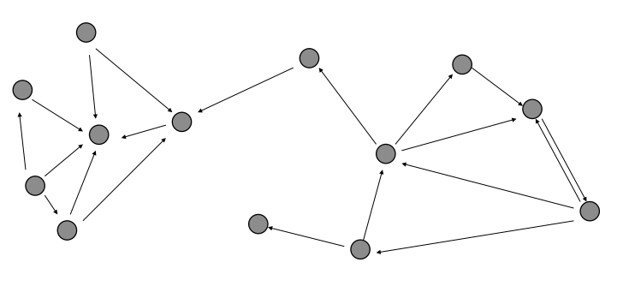
Performing a link analysis
We can extract from the link structure some further information that is going beyond mere document content.
Web document is in a form of Hypertext.
Definition (Hypertext)
A Hypertext is a set of vertices (nodes) and directed edges (links) forming a graph. The Web can be regarded as a cyclic graph.

Slide 33
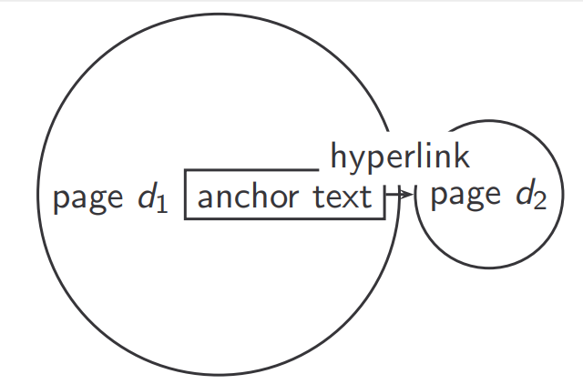
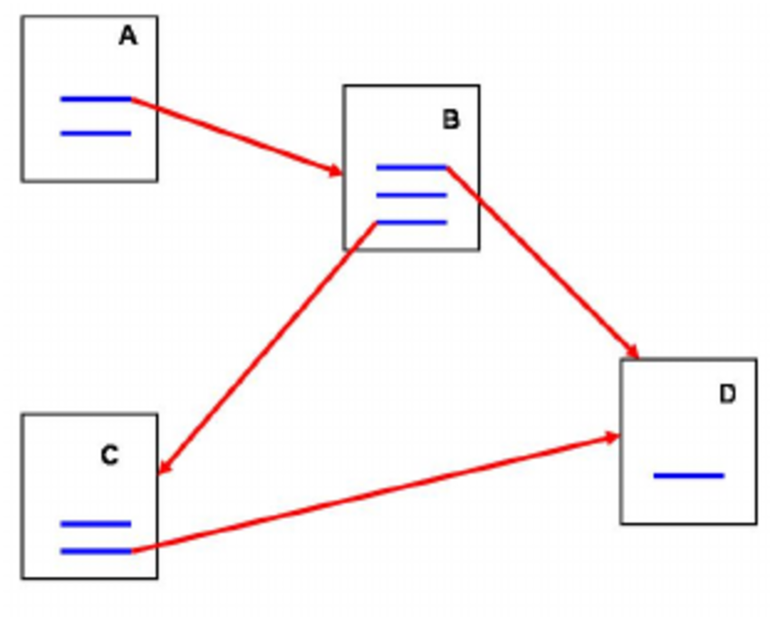
The web as a directed graph
Assumption 1: A hyperlink is a quality signal.
The hyperlink d1 → d2 indicates that d1’s author deems d2 high-quality and relevant.
A document is more authoritative, the more other documents link to it
The authoritativeness, can propagate to its successor nodes

Slide 34
PageRank based on Links [Page et al., 1998]
We assume page A has pages T1 ... Tn which point to it (i.e., linked). The parameter d is a damping factor which can be set between 0 and 1. Usually set d to 0.85.
There are more details about d (later).
Also C(A) is defined as the number of links going out of page A.
The PageRank of a page A is given as follows:
PR(A) = (1-d) + d (PR(T1)/C(T1) + ... + PR(Tn)/C(Tn))
Note that the PageRanks form a probability distribution over web pages, so the sum of all web pages' PageRanks will be one.
BUT …

Slide 35
Google bombs
Google bombs refer to the practice of causing a website to rank highly in web search engine results for irrelevant, unrelated or off-topic search terms by linking heavily.
By January 2007, however, Google had tweaked its search algorithm to counter popular Google bombs such as "miserable failure" leading to George W. Bush and Michael Moore
In contrast, search engine optimization (SEO) is the practice of improving the search engine listings of web pages for relevant search terms.

Slide 36
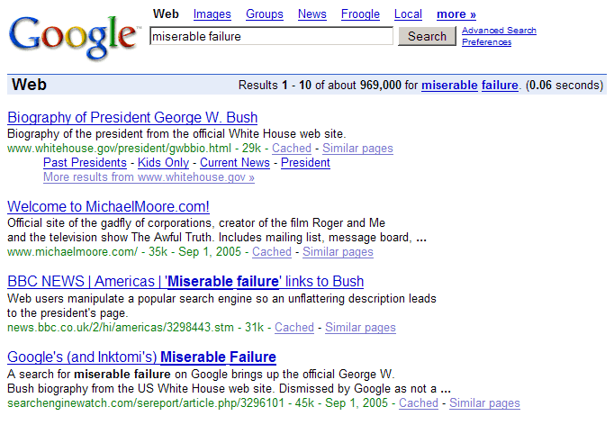
A historic google bomb
An example of Google bombing in 2006 that caused the search query "miserable failure" to be associated with George W. Bush and Michael Moore.

Slide 37
Importance of Anchor text
Assumption 2: The anchor text describes the content of d2.
“You can find cheap cars <a href=http://...>here</a>.”
“<a href=http://...> You can find cheap cars here</a>”
Anchor text: “You can find cheap cars here”
Searching on [text of d2] + [anchor text → d2] is often more effective than searching on [text of d2] only
Example: Query IBM
Matches IBM’s copyright page
Matches IBM wikipedia article
May not match IBM home page! (a lot of graphics)
Searching on [anchor text → d2] is better for the query IBM.
In this representation, the page with the most occurrences of IBM is www.ibm.com.

Slide 38
Anchor text containing IBM and pointing to www.ibm.com
www.nytimes.com: “IBM acquires Webify” www.slashdot.org: “New IBM optical chip” www.stanford.edu: “IBM faculty award recipients”
wwww.ibm.com
Thus: Anchor text is often a better description of a page’s content than the page itself.
Anchor text can be weighted more highly than document text. (based on Assumptions 1&2)

Slide 39
Origins of PageRank based on Anchor: Citation Analysis
We used the same formal representation (as DAG) for citations in the scientific literature
“This process of deriving a query from an information need in the web context has received a great deal of attention: Holscher and Strube [HS00] point out that experienced and novice users construct searches differently, Navarro-Pietro et al. [NSR99] derived a cognitive model for web search, Muramatu and Pratt [MR01] explore users' mental model of search engines, etc. See also [CDT99]. However, all this literature shares the assumption that web searches are motivated by an information need.”
Appropriately weighted citation frequency is an excellent measure of quality for scientific publications.
We can do the same for hyperlinks on the web
That is calculate a weighted link frequency on the web

Slide 40
PageRank with anchor text
Using the inverted index, it retrieves all hits of a query term in a document (full text, fancy and anchor)
Based on the hits computes the dot product between a type-weight vector (full text, anchor, fancy) and a count-weight vector (counting number of full text, anchor and fancy hits) to create the document score (RSV)
The RSV are combined to produce the final PageRank
What about the anchor links to non-existing page?

Slide 41
Random walk and Long-term visit rate (graph theory)
Solving google bomb and anchor to a non exists page

Slide 42
Model behind PageRank: Random walk
Imagine a web surfer doing a random walk on the web
Start at a random page
At each step, go out of the current page along one of the links on that page, equiprobably
In the steady state, each page has a long-term visit rate (LTVR is the same concept of RSV)
This long-term visit rate is the page’s PageRank.
PageRank = long-term visit rate
= steady state probability

Slide 43
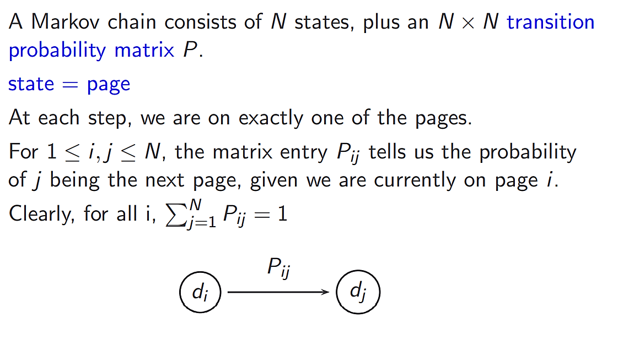
Formalisation of random walk: Markov chains

Slide 44
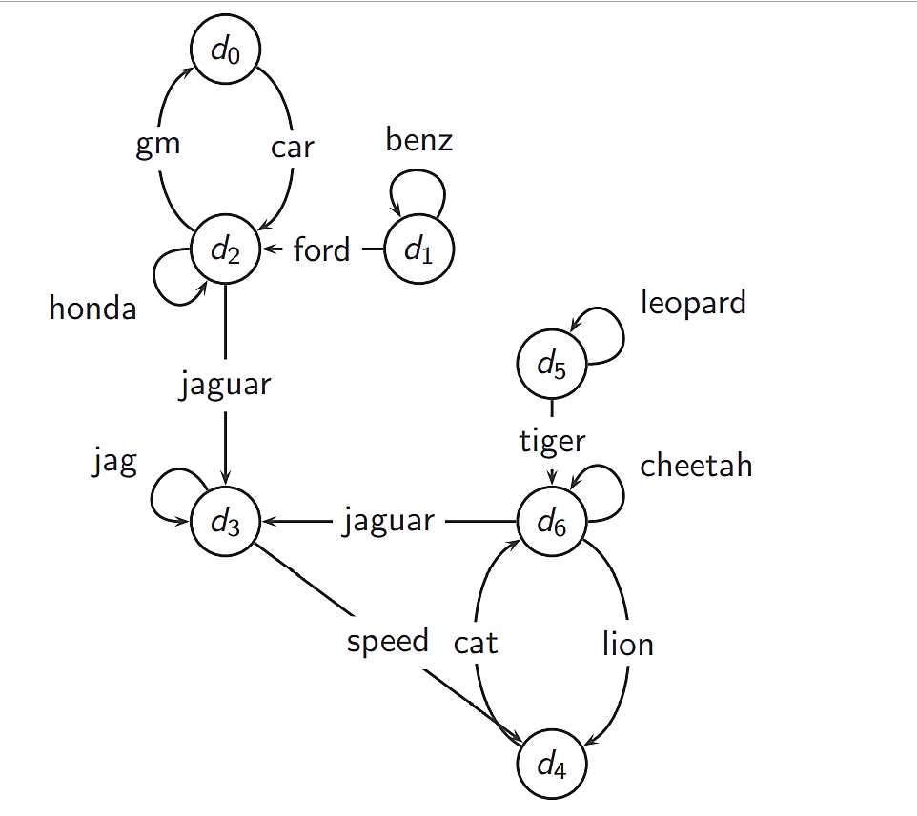
Example web graph

Slide 45
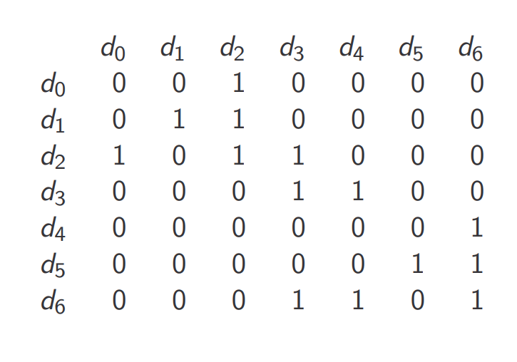
Link matrix for example

Slide 46
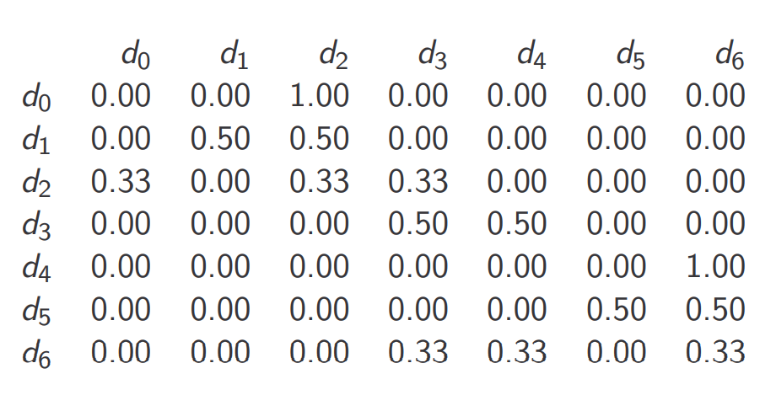
Transition probability matrix P for example (with equiprobably)

Slide 47
Long-term visit rate
Recall: PageRank = long-term visit rate
Long-term visit rate of page d is the probability that a web surfer is at page d at a given point in time.
Next: what properties must hold of the web graph for the long-term visit rate to be well defined?
The web graph must correspond to an ergodic Markov chain.
First a special case: The web graph must not contain dead ends.
(ergodic: positive recurrent aperiodic state of stochastic systems; tending in probability to a limiting form that is independent of the initial conditions)

Slide 48
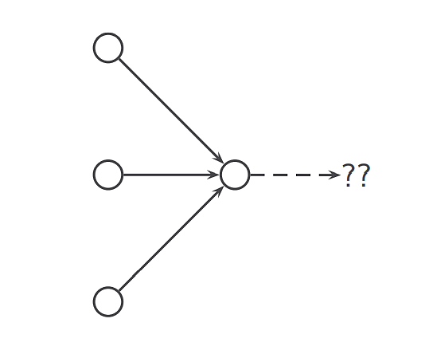
Dead ends
The web is full of dead ends.
Random walk can get stuck in dead ends.
If there are dead ends, long-term visit rates are not well-defined (or non-sensical).

Slide 49
Teleporting – to get us out of dead ends
At a dead end, jump to a random web page with prob. 1/N.
At a non-dead end, with probability 10%, jump to a random web page (to each with a probability of 0.1/N).
With remaining probability (90%), follow a random hyperlink on the page.
For example, if the page has 4 outgoing links: randomly choose one with probability (1-0.10)/4=0.225
10% is a parameter, the teleportation rate. (damping factor)
Note: “jumping” from dead end is independent of teleportation rate.

Slide 50
Result of teleporting
With teleporting, we cannot get stuck in a dead end.
But even without dead ends, a graph may not have well-defined long-term visit rates.
More generally, we require that the Markov chain be ergodic.

Slide 51
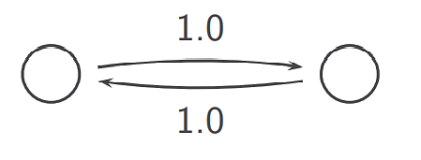
Ergodic Markov chains
A Markov chain is ergodic iff it is irreducible and aperiodic.
Irreducibility. Roughly: there is a path from any page to any other page.
Aperiodicity. Roughly: The pages cannot be partitioned such that the random walker visits the partitions sequentially.
A non-ergodic Markov chain:

Slide 52
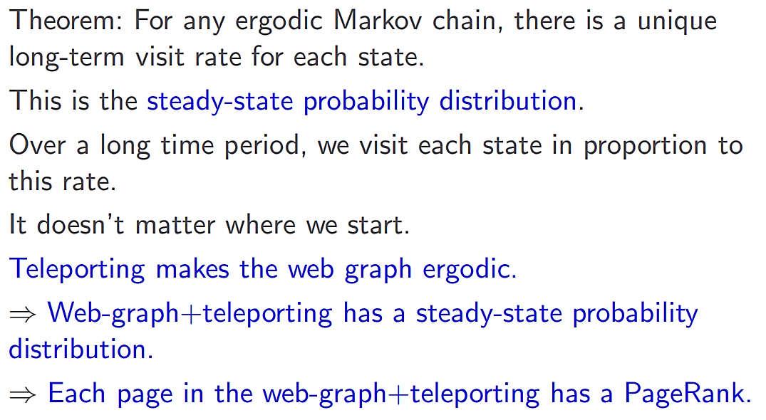
Ergodic Markov chains

Slide 53
Where we are
We now know what to do to make sure we have a well-defined PageRank for each page.
Next: how to compute PageRank

Slide 54
PageRank Calculation With Probability vector

Slide 55
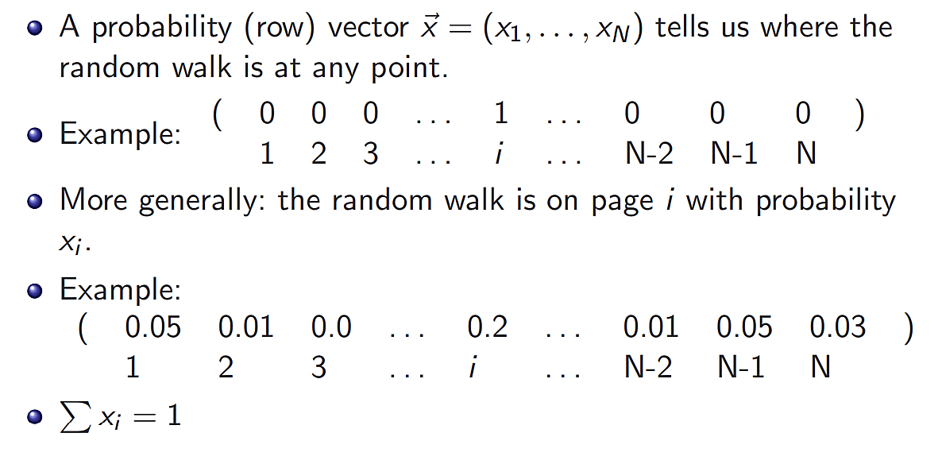
Formalization of “visit”: Probability vector

Slide 56
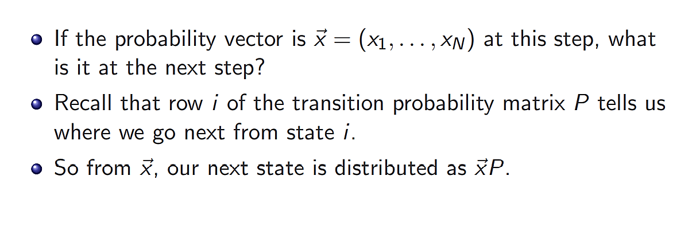
Change in probability vector

Slide 57
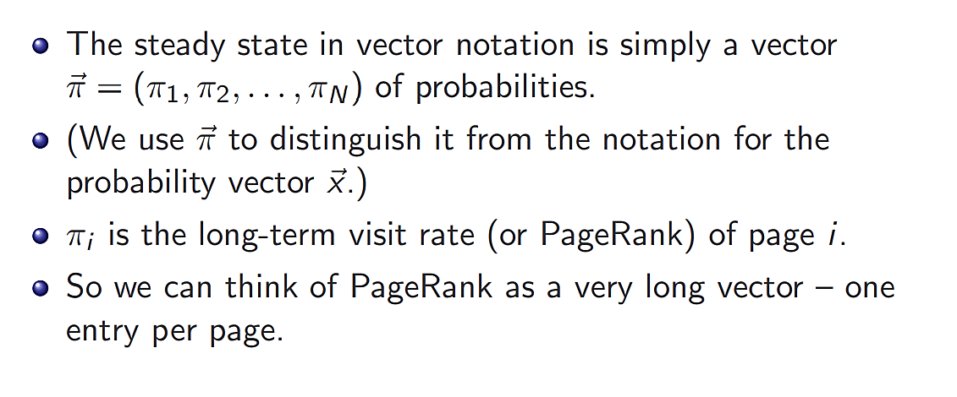
Steady state in vector notation

Slide 58
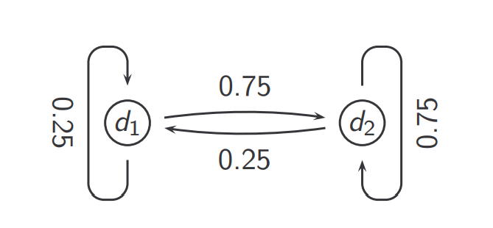
Example
Calculate the PageRank in this example

Slide 59
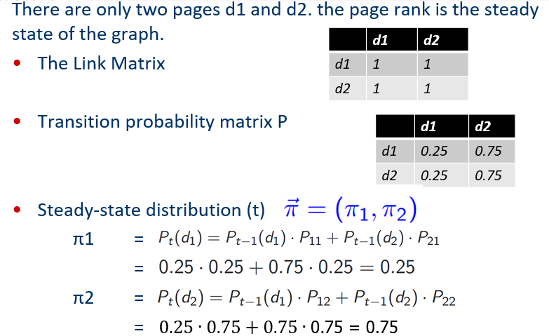
PageRank

Slide 60
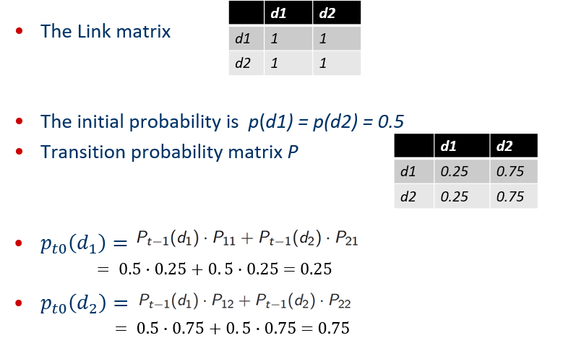
Assume initial probability is 0.5

Slide 61
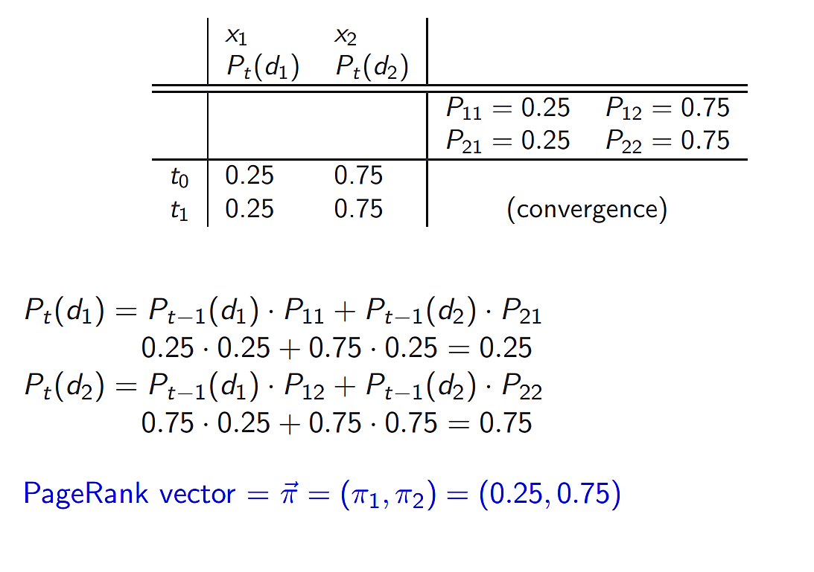
Formalised Expression

Slide 62
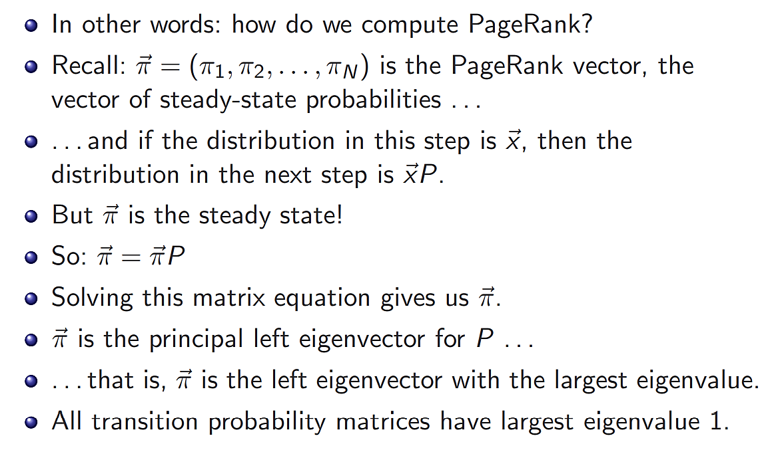
How do we compute the steady state vector?
https://www.youtube.com/watch?v=kSmQbVxqOJc

Slide 63
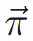
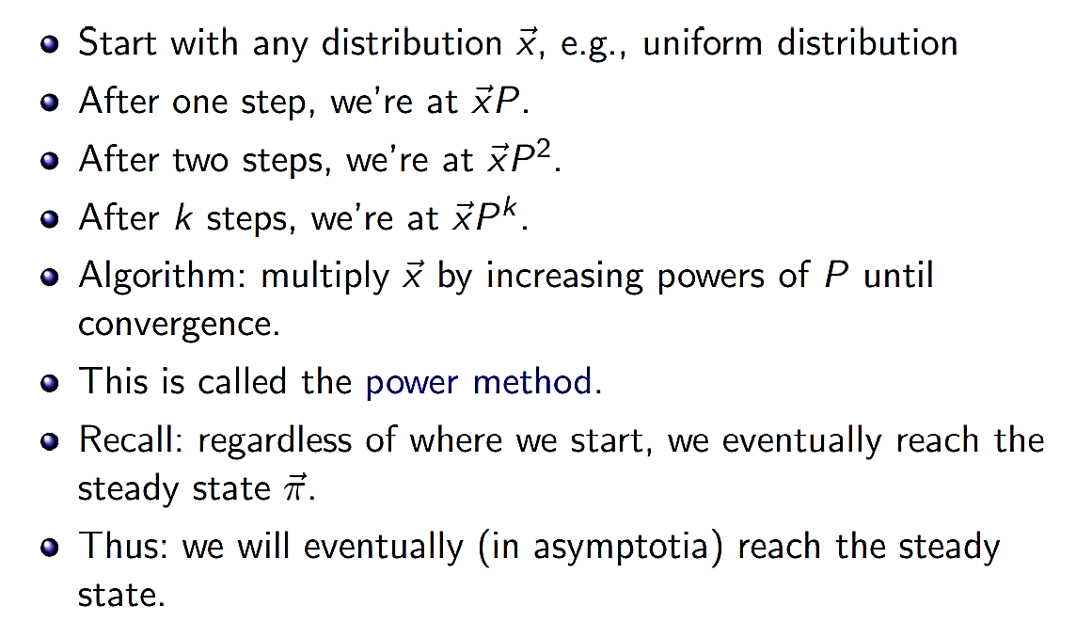
One way of computing the PageRank

Slide 64
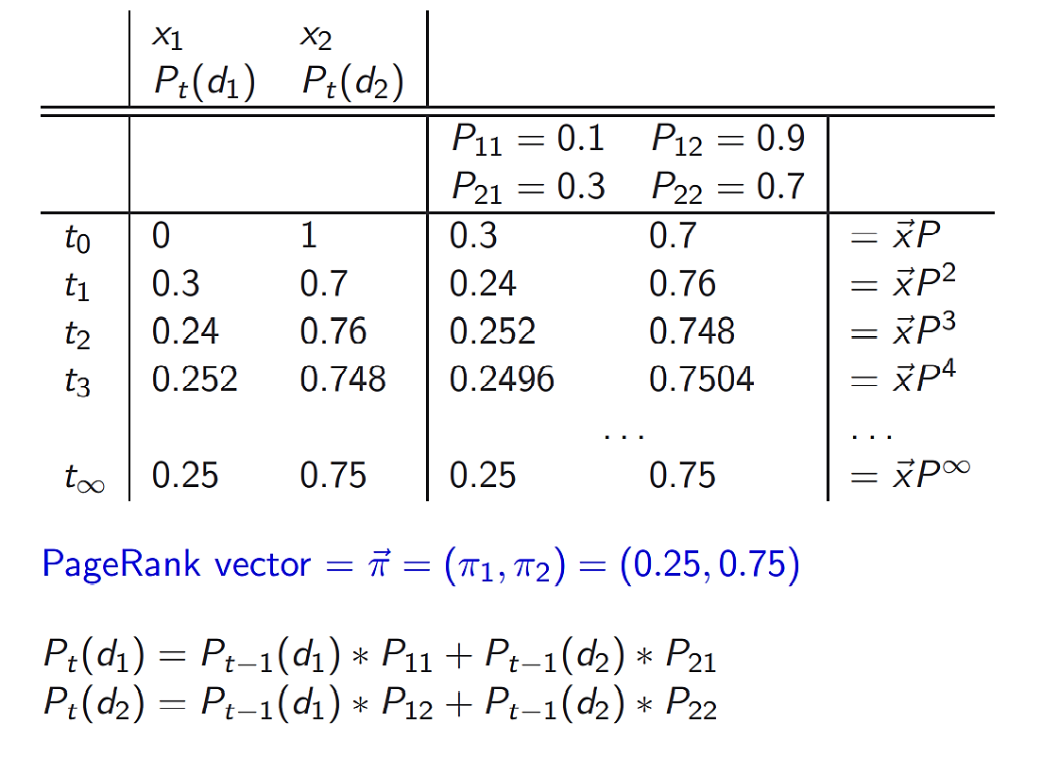
Another Example (power method)

Slide 65
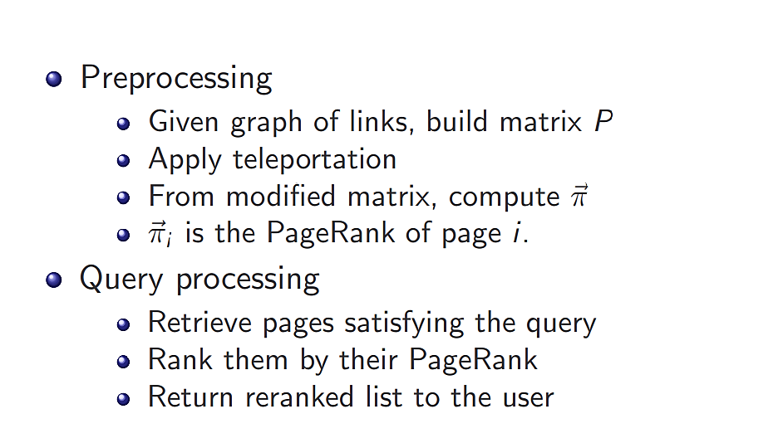
PageRank Summary

Slide 66
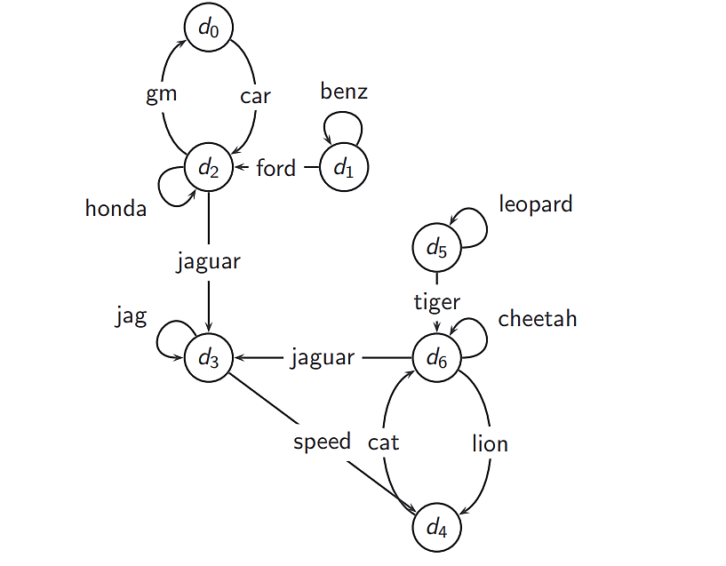
A Complete Example

Slide 67
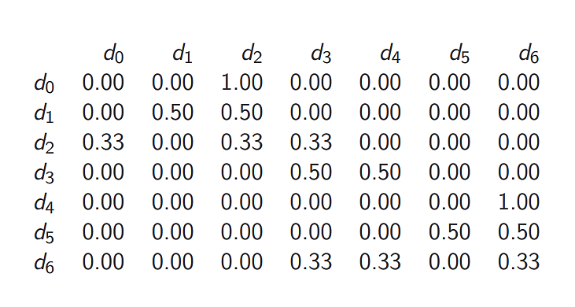
Step 1. Calculate Transition Matrix P

Slide 68
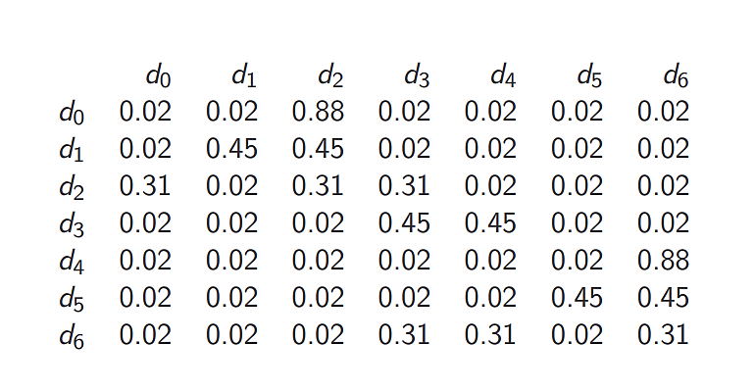
Step 2. Add teleporting into P

Slide 69
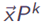
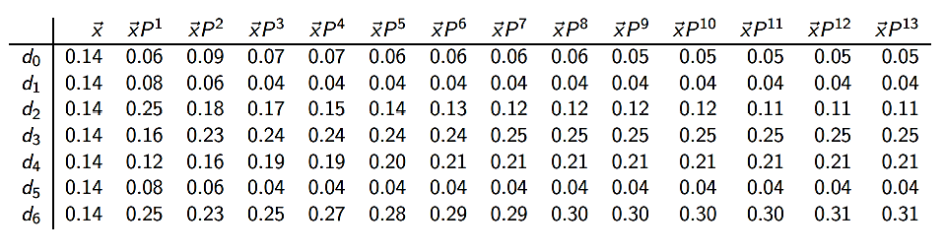
Step 3. Calculate Using Power method
Convergency achieved at 12!

Slide 70
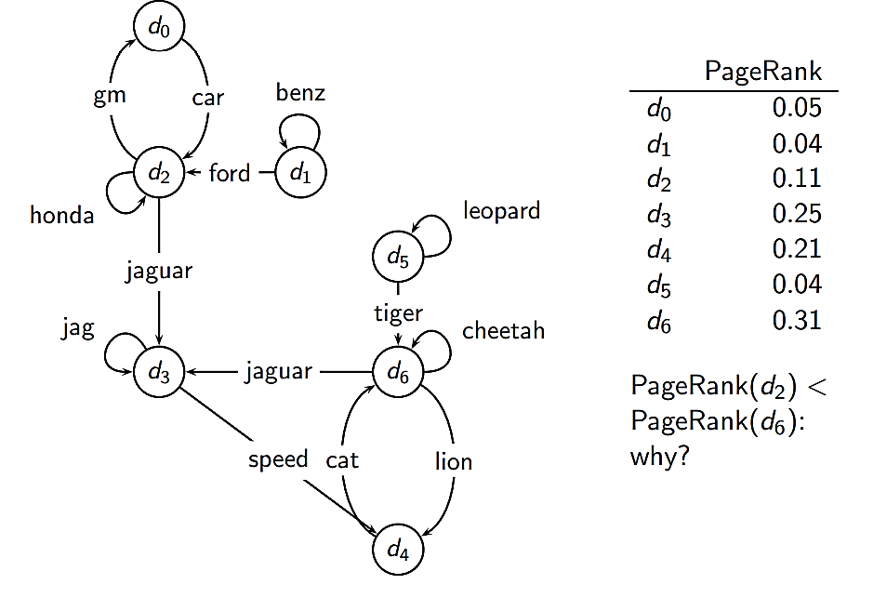
Analysis

Slide 71
PageRank issues
Real surfers are not random surfers.
Examples of non-random surfing: back button, short vs. long paths, bookmarks, directories – and search!
→ Markov model is not a good model of surfing.
But it’s good enough as a model for our purposes.
Simple PageRank ranking (as described on previous slide) produces bad results for many pages.
Consider the query “video service”.The Yahoo home page (i) has a very high PageRank and (ii) contains both video and service. If we rank all Boolean hits according to PageRank, then the Yahoo home page would be top-ranked.
Clearly not desirable
In practice: rank according to weighted combination of raw text match, anchor text match, PageRank & other factors

Slide 72
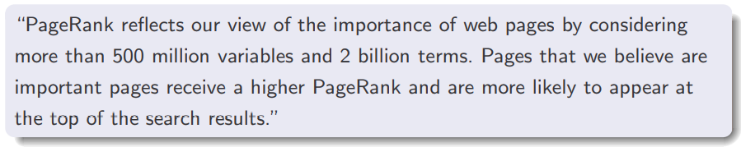
How important is PageRank?
Frequent claim: PageRank is the most important component of web ranking. The reality:
There are several components that are at least as important: e.g., anchor text, phrases, proximity, tiered indexes . . .
Rumour has it that PageRank in its original form (as presented here) now has a negligible impact on ranking
However, variants of a page’s PageRank are still an essential part of ranking.
Google’s official description of PageRank:

Slide 73
Review
What is characters of Web in terms of large document repository in comparison with the conventional IS?
Why Link is important?
What efforts Google did for using Hypertext (anchor and links)?
What properties must hold of the web graph for the long-term visit rate to be well defined?
What is Teleporting in the Random walk model? Why is it important?
How to calculate PageRank with page links and the transition probability matrix P?

